Slide 1
Dateligens – Pitch Deck
Fortify your data security and unlock greater financial potential

Slide 2
Dateligens Systems founders
Philippe VOLTO - CEO
« And a highly motivated team of 11 people! »
25 years in IT services
Team lead for EU cloud automation
Technical architect for french banks
Jean-Michel INVERNIZZI - CSO
Strategic guidance for innovative products
DAP Product manager
Project manager in industry
Georges GEORGOULIS - CTO
30 years of software experience
GDPR data privacy setup for a telecom operator
Business consultant for telecom suppliers

Slide 3
Growing problem
How can we harmonize the imperative of safeguarding increasingly vast volumes of sensitive big data with the imperative of leveraging these data in a more lucrative manner?

Slide 4
Our solution is DAP

Slide 5
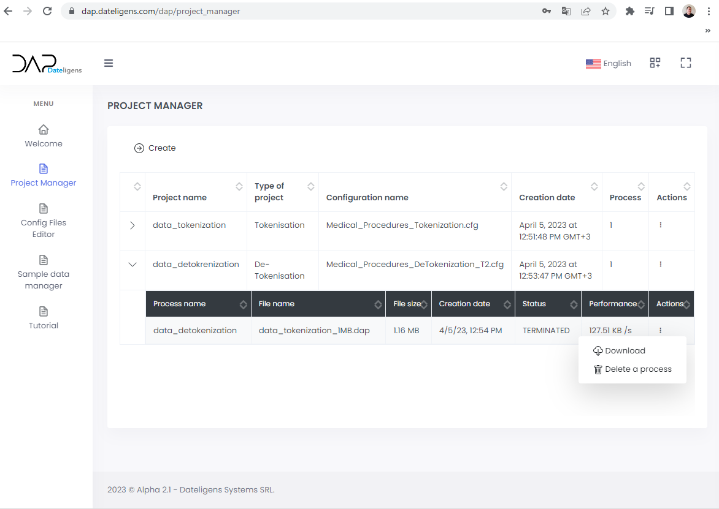
DAP is a software platform
DAP is a Dynamic Big Data Security platform for Massive Data anonymization / pseudonymization / k-anonymization / encryption for B2B (SME and Corporates) customers.
It can be installed On-Premises or in SaaS mode (Cloud) with strong innovations.
Unlike many software programs used for encrypting all data, from a document, a file or a directory, that are stored on a hard drive or in the Cloud (Data At Rest), DAP secures also sensitive data in Big data flows (Data In Motion), while allowing the normal use of non-sensitive data, in their initial form, by the users without impacting their business processes.

Slide 6
Technical overview
Measured processing speed: 100 GBytes/Hour on a EU Top 10 bank VMware private cloud (stored encrypted data), 250 GBytes/Hour on AWS EMR.
Compliance statements: DAP is totally adhering to relevant data protection regulations and industry-specifics standards. This includes compliance with regulations such as the GDPR (General Data Protection Regulation), CCPA (California Consumer Privacy Act), or other applicable data protection laws. DAP has passed the PIA of a major French bank (DPO Privacy Impact Assessment).
Troubleshooting and support: a Standard support is included, a 24/7 extended support is available through our options, by the intermediary of a third part support team (international integrator and support services company).

Slide 7
How To
A “NO CODE” web interface with online training and help.
DAP adapts to all "BUSINESS" functions, includes NON-IT functions.
DAP adapts to level of sensitivity, the main tokenization algorithms proposed by DAP are SHA256 and SHA512 (US Federal Government Processing Standard for Civil use) and AES-256 (Military grade encryption standards).
The solution frees up IT department, CISO, CDO and DPO teams time so they can concentrate on other issues.

Slide 8
Demo platform in manual mode

Slide 9
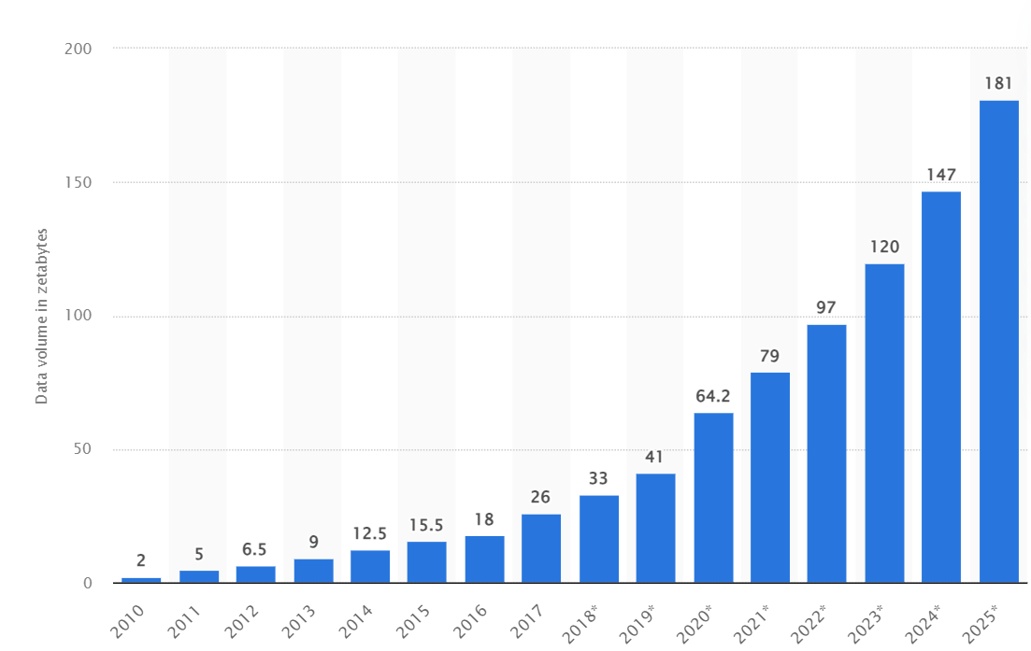
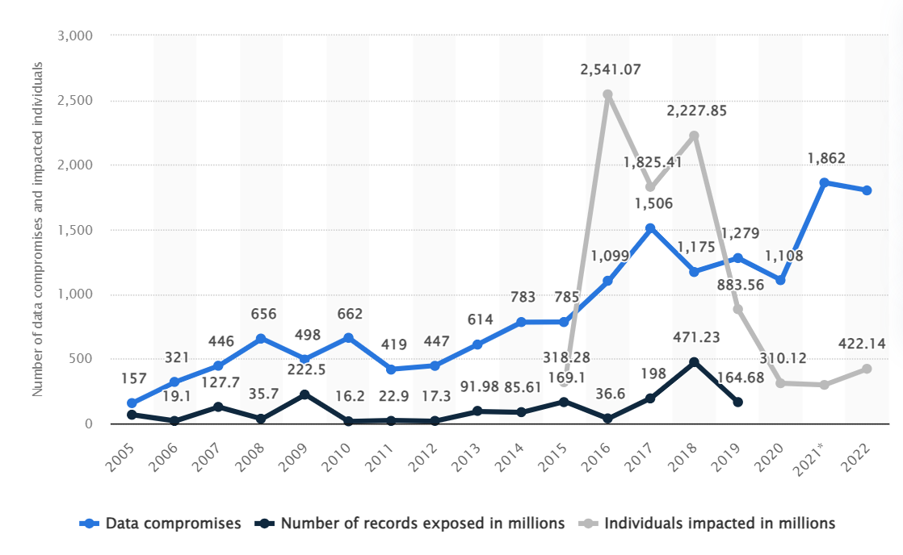
More and more data … and sensitive data
Data volume in the world in 2023
Sensitive data misappropriation in 2022
120 zettabytes of data today in the world.
1 Zettabyte (ZB) = 1,099 512 ×10¹² Gigabytes (GB)
Even with all the cybersecurity existing protections, more than 400 millions of people were directly impacted by sensitive data accessed by an unauthorized threat actor

Slide 10
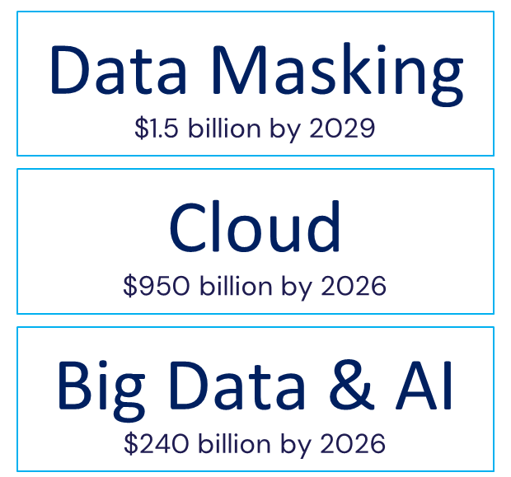
Market & Drivers
Beachhead Market
Healthcare
Other Markets
Retail, Insurance, Finance,
Town Halls & Cities, Industry,
Datacenters, Public Sector,
Defense, police and army …

Slide 11
Business Model, Adoption, Sales
Business model
Adoption strategy
Sales projection

Slide 12
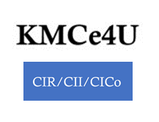
Partners and ecosystem
Tech partners & Marketplaces
IT integrators & Cybersec partners
Governmental programs
Investment & Funding
Green IT & Carbon offseting

Slide 13
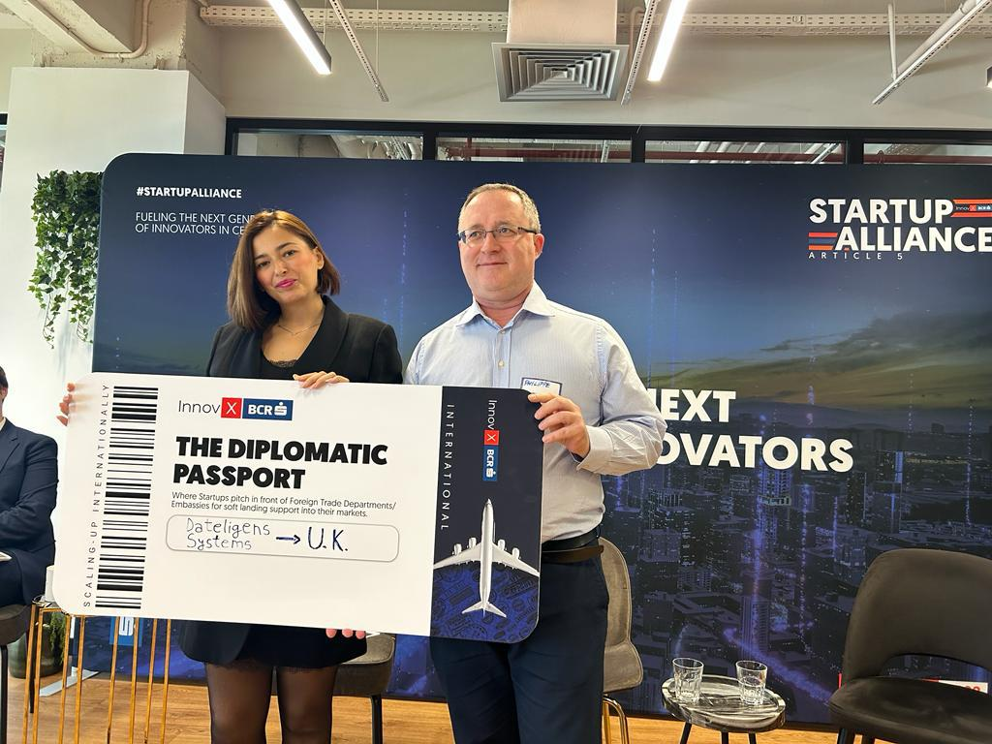
UK FCDO & DBT support
Dateligens received "The Diplomatic Passport" award from Cristina Dragu, Director "Foreign Direct Investment" of the British Embassy, at the InnovX BCR "Pitch Enter New Markets" event on May 16, 2023.
A "Dateligens UK" subsidiary project has been initiated with the UK gov agencies FCDO (Foreign Office) and the DBT (Department for Business & Trade) under the reference DHP-00029760.

Slide 14
Fundraising
2024 Q1
Finalization of our Pre-seed round with our investor KMCe4U for a post-money valuation of 2.5 Meuros (KMCe4U is a french R&D Credit Tax company).
2024 Q2
Complementary Early Stage round
300 Keuros with SeedBlink in category “Community Stars” (in progress).
700 Keuros VC-Backed.
The funds raised are 55% dedicated to sales and marketing development (particularly on the Microsoft Azure and UIPath marketplaces) and 45% to R&D efforts.

Slide 15
Thanks!
Together, let's shape the future of sensitive data-driven success
With Dateligens, transform possibilities into realities!
philippe.volto@dateligens.com
+33 6 81 57 21 33
+40 790 597 992
www.dateligens.com

